Slide 1
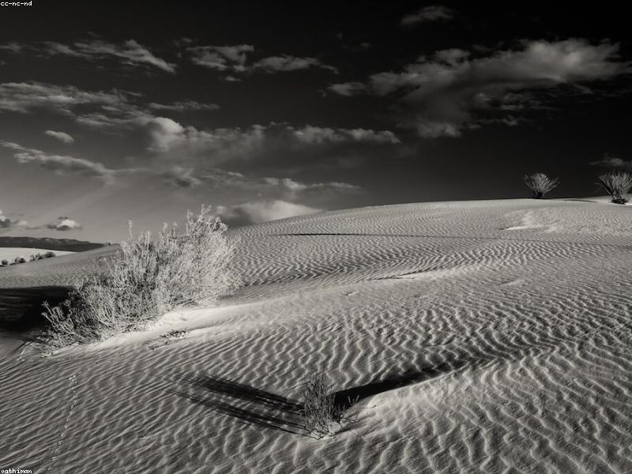
Introduction to Deserts
- Definition of deserts
- Types of deserts (hot, cold, coastal, etc.)
- Importance of deserts in the ecosystem
- Overview of desert climates
- Unique features of desert landscapes

Slide 2
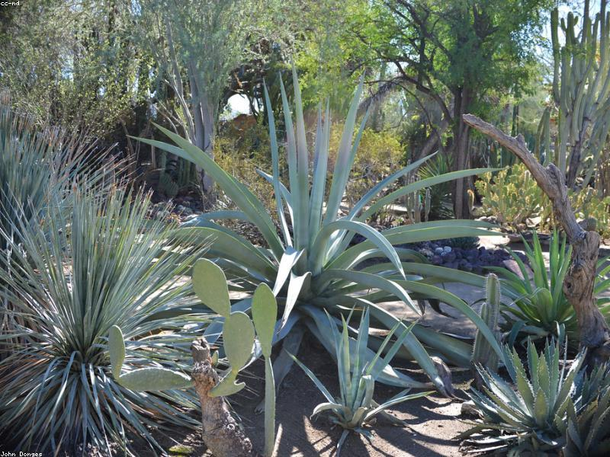
Flora of Deserts
- Types of plants found in deserts (cacti, succulents)
- Adaptations of desert plants (water storage, drought resistance)
- Role of plants in desert ecosystems
- Examples of specific desert flora (e.g., Joshua tree)
- Importance of plant life for wildlife

Slide 3
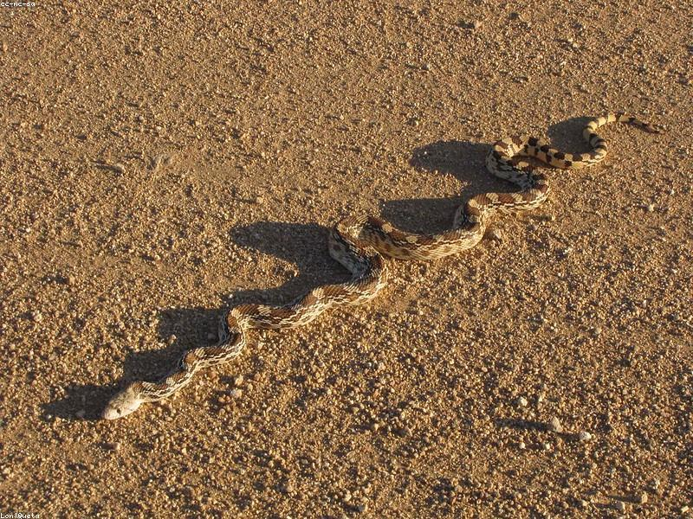
Fauna of Deserts
- Overview of animals that inhabit deserts (mammals, reptiles, birds)
- Adaptations of desert animals (nocturnal behavior, water conservation)
- Examples of specific desert fauna (e.g., fennec fox, rattlesnake)
- Food chains in desert ecosystems
- Importance of biodiversity in deserts

Slide 4
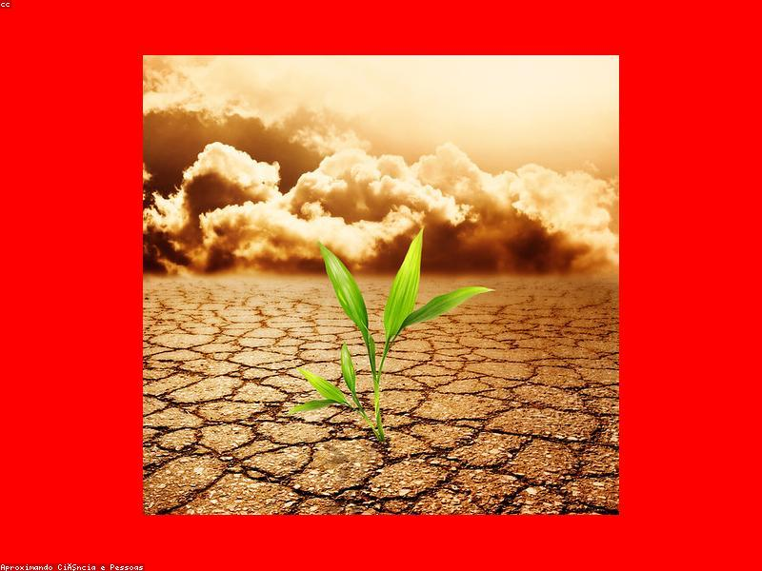
Threats to Desert Ecosystems
- Human impact on desert environments (urbanization, pollution)
- Climate change effects on desert wildlife
- Conservation efforts for desert ecosystems
- Importance of protecting desert habitats
- Role of organizations in desert conservation

Slide 5
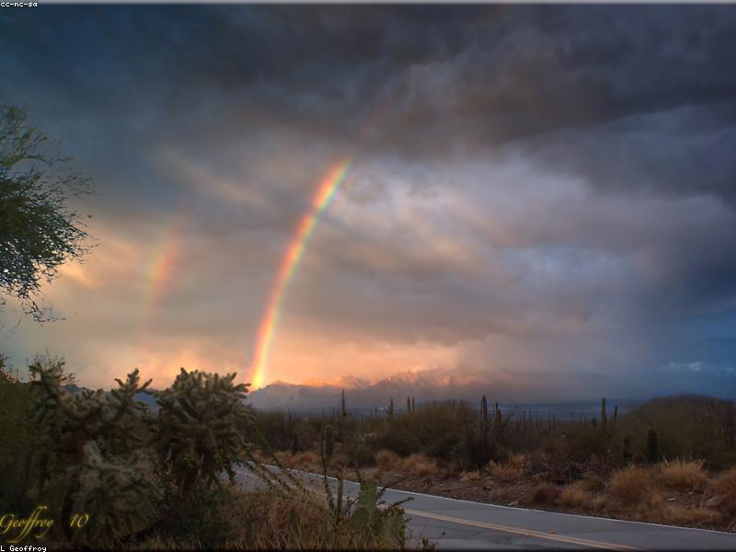
Conclusion
- Summary of key points about deserts and wildlife
- Importance of deserts to the planet
- Call to action for conservation efforts
- Encouragement to learn more about desert ecosystems
- Final thoughts on the beauty of deserts

